Slide 1
Brief Overview of CSE472
Abdus Salam Azad

Slide 2
What Is Machine Learning
Tom Mitchell - Improving with experience at some task
Wikipedia - Machine learning is a scientific discipline that explores the construction and study of algorithms that can learn from data
Algorithms that can improve their performance using training data

Slide 3
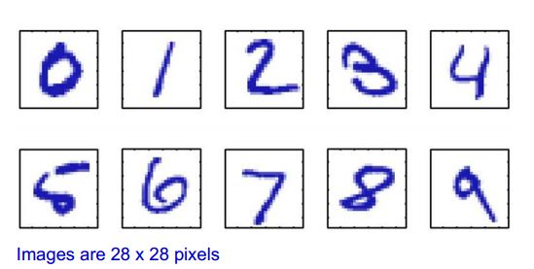
Example – Character Recognition(Classification)
Lets say we have 1000 worked-out examples
We can then train an algorithm with these examples, which can then recognize unseen examples

Slide 4
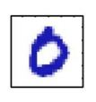

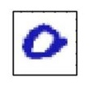

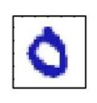

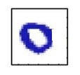
Training Examples
Image | Classification
 | Zero
 | Three
 | Five
 | Nine
Image | Classification
 | Zero
 | Zero
 | Zero
 | Zero

Slide 5
ZERO
LearningAlgorithm
Input / Unknown Example
Training Examples

Slide 6
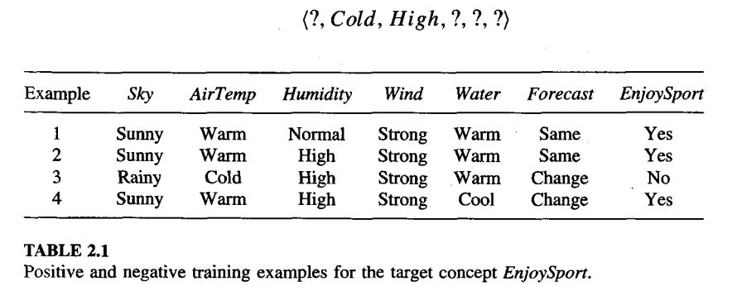
Enjoy Sports (Classification)

Slide 7
Function Approximation/ Regression
We have information about Tamim Iqbal’s last 100 One Day innings
What will be Tamim Iqbal’s score if??
Weather – Mild, Pitch – Flat, Venue-Dhaka D/N- No
Weather | Venue | Pitch | Day/Night | … | Run
Cold | Mirpur | Flat | Yes | … | 0
Mild | Auckland | Green | Yes | … | 0
Sunny | Lords | Dusty | No | … | 83
… | … | … | … | … | …
Cold | Mirpur | Flat | No | … | 10

Slide 8
Supervised Learning
Unsupervised Learning
Semi-Supervised Learning

Slide 9
Problems that can be solved
Classification
Clustering
Regression
And others

Slide 10
Covered Topics in this Lab(Tentative) / Sessional Outcome
Concept Learning: Decision Trees
Naive Bayesian Classifier
Semi-supervised Learning: with Decision Tree
Ensemble Learning: with Decision Tree
Instance Based / Lazy Learning: k nearest Neighbour Learning
Re-inforcement Learning

Slide 11
Reference Book
Machine Learning
Tom Mitchell, McGraw Hill, 1997.

Slide 12
Data Sets
http://archive.ics.uci.edu/ml/
Old : http://kdd.ics.uci.edu/

Slide 13
Resources (For making this slide)
http://en.wikipedia.org/wiki/Machine_learning
Machine Learning - Tom M. Mitchell
http://www.robots.ox.ac.uk/~az/lectures/ml/lect1.pdf

